Slide 1
Prenatal diagnosis
Dr.Maysarah M. AL-Badran
M.B.ch.B,C.A.B.O.G,F.I.C.M

Slide 2
Aim
To make undergratuate familiar with the tests used for screening and dignosis of fetal abnormality.

Slide 3
Screening test
All women
Non invasive
Include:
Family hx,past obtetric hx
maternal biochemistry , virology and U/S

Slide 4
Diagnostic tests
High risk pregnancies
Invasive
Risk of miscarrige
Include:U/S,amniocentesis,CVS, cordocentesis

Slide 5
Amniocentesis
At or after 15 wk
Risk of miscarrige 0.5-1%
Earlier amniocentesis is more risk

Slide 6
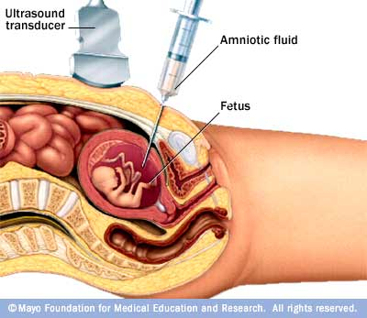

Slide 7
Chorionic villus sampling
At after 10 wk
Risk of miscarrige 2-3%
If performed before 10 wk:limb distruption and cleft lip/palate

Slide 8
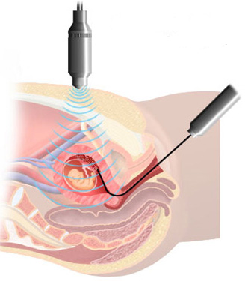
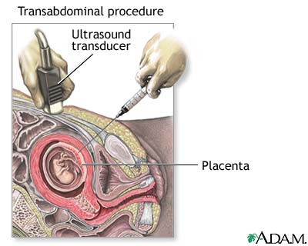

Slide 9
Cordocentesis
At or after 20 wk
Greater risk of miscarrige than amniocentesis and CVS

Slide 10
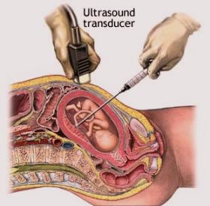

Slide 11
Laboratory analysis
Karyotyping
Fluorescence in situ hybridization(FISH)
Polymerase chain reaction(PCR)

Slide 12
Screening for Down’s syndrom
Hx.
Triple test
Nuchal transulency

Slide 13
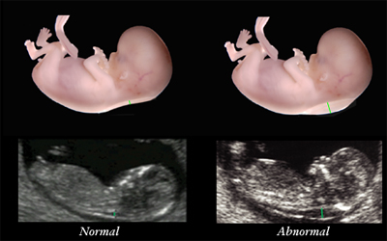

Slide 14
Structural abnormality
Neural tube defects:
AFP increase in open NTD-→U/S
Anencephaly&encephalocele can be detected on first trimester U/S
Spina bifida:’lemon’&’banana’sign
Can be prevented by folic acid

Slide 15
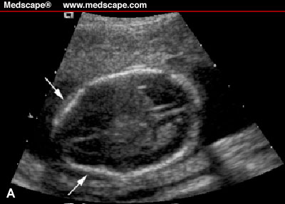

Slide 16
Congenital heart defects
Genetic,maternal DM,viral inf.,lithium
Screening by U/S &fetl echo.

Slide 17
Screening for congenital viral &parasitic inf
Rubella is screened for routinely
Susceptible women →vaccinated postpartum

Slide 18
Dx of congenital viral &parasitic inf.
If maternal inf. is confirmed→serial fetal U/S
Eg.parvovirus→hydrops.toxoplasmosis&CMV→microcephaly or ventriculomegaly,IUGR,hepatomegaly.

Slide 19
Non invasive prenatal Dx
Either fetal cells in the maternal circulation or cell-free fetal DNA to detect aneuploidy.

Slide 20
Preimplantation genetic Dx
By IVF cycle,embryo biopsy is performed as early as 6-8 cell stage or at blastocyst to perform genetic testing before pregnancy to avoid termination of pregnancy.

Slide 21
Other methods of AN diagnosis
3-D ultrasound
Fetal MRI

Slide 22
RESOURCES
Obstetric by ten teacher 2010
Dewhurst`s textbook of obstetric and gynaecology 2007

Slide 23
THANK YOU

